Slide 1

Week 3: Inferential Statistics 2 Correlation and Chi Square
Professor Jiamei Deng & Ah-Lian Kor

Slide 2
2 Inferential Statistics
We shall look at two types of Level 2 inferential Statistical Analysis
Correlation
Chi-Test

Slide 3
Correlation
Correlation depicts the relationship (or lack of relationship) between two numeric variables.
We shall look at the following:
Types of correlation
Scatterplots
Types of correlation tests
Correlation Coefficient (r)
Correlation hypotheses testing

Slide 4
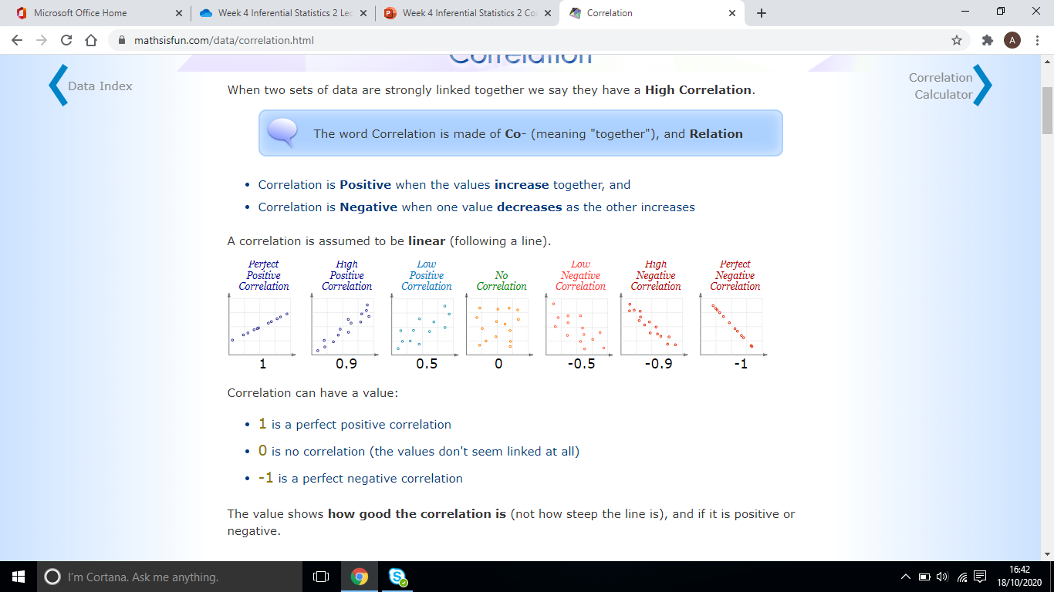
Types of correlation
Source https://www.mathsisfun.com/data/correlation.html

Slide 5
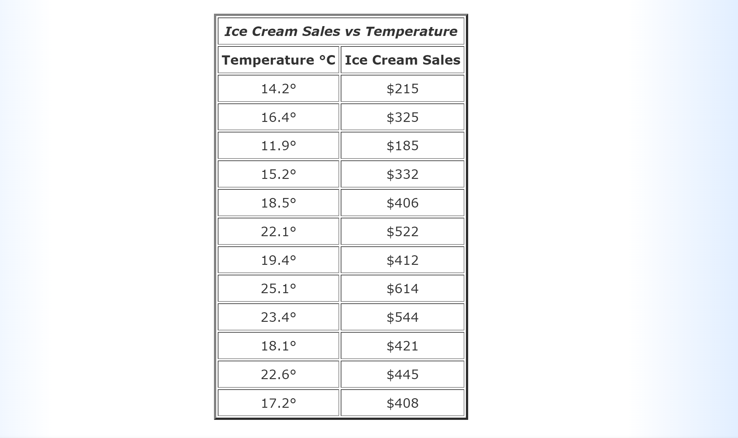
Example:
The local ice cream shop keeps track of how much ice cream they sell versus the noon temperature on that day. Here are their figures for the last 12 days:

Slide 6
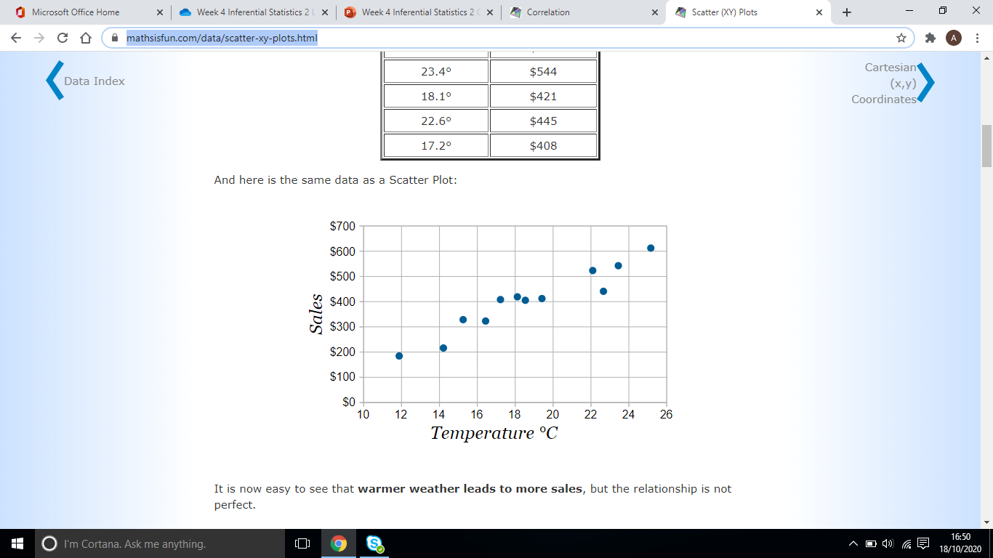
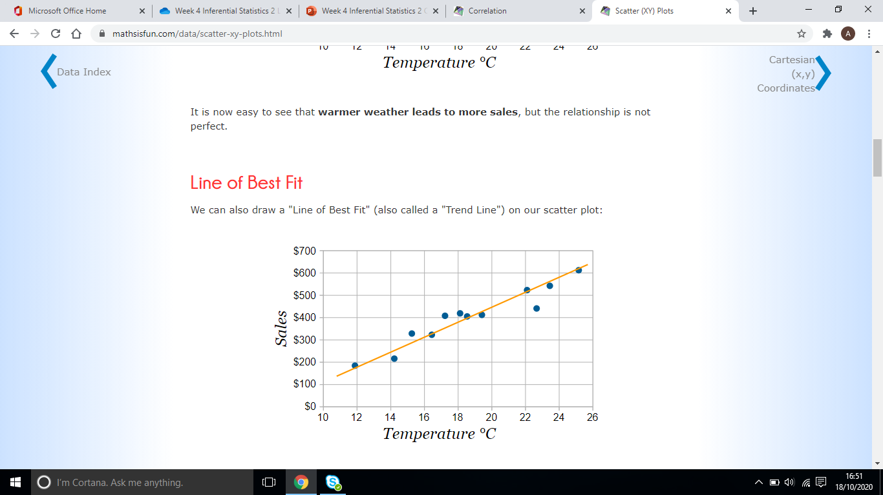
Scatterplots and Correlation
Scatterplots (and its trend) show the correlation between two variables (e.g. the sales of ice cream and weather temperature)
Resource
https://www.mathsisfun.com/data/scatter-xy-plots.html

Slide 7
Types of Correlation Tests
Pearson Correlation
The Pearson correlation evaluates the linear relationship between two continuous variables. A relationship is linear when a change in one variable is associated with a proportional change in the other variable.
Spearman Rank Order Correlation
The Spearman correlation evaluates the monotonic relationship between two continuous or ordinal variables. In a monotonic relationship, the variables tend to change together, but not necessarily at a constant rate. It is a non-parametric test.
Tau Kendall Correlation
It is a non-parametric test. It can be used with ordinal or continuous data. It is a statistic of dependence between two variables.
Sources
https://support.minitab.com/en-us/minitab-express/1/help-and-how-to/modeling-statistics/regression/supporting-topics/basics/a-comparison-of-the-pearson-and-spearman-correlation-methods/
https://ademos.people.uic.edu/Chapter22.html

Slide 8
Quantification of Relationships
Correlations
Bivariate: Both variables will have to be quantitative or numerical data
Formula for calculating correlation coefficient

Slide 9
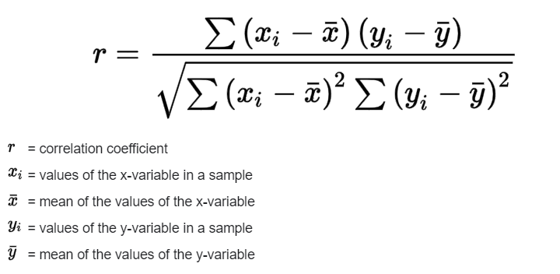
Pearson Correlation Coefficient, r for a sample (see example in excel file)

Slide 10
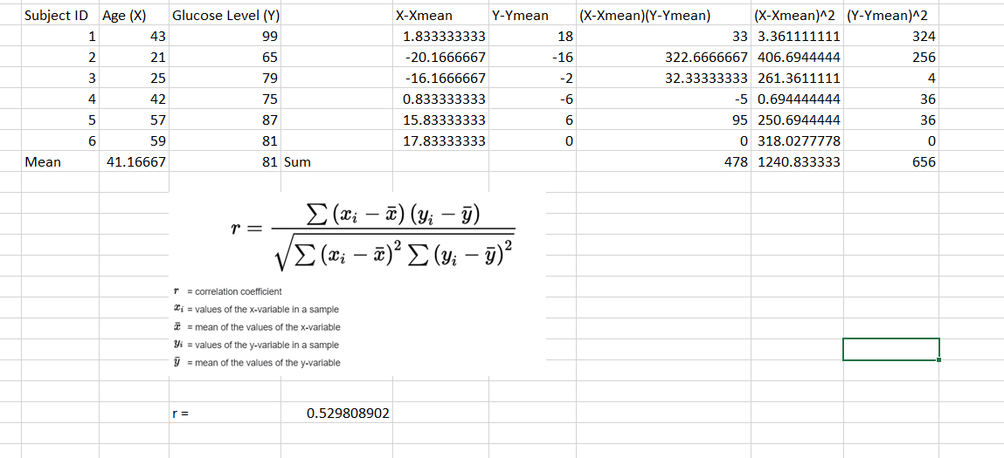
Example Alternative formula https://www.statisticshowto.com/probability-and-statistics/correlation-coefficient-formula/

Slide 11
Questions?

Slide 12
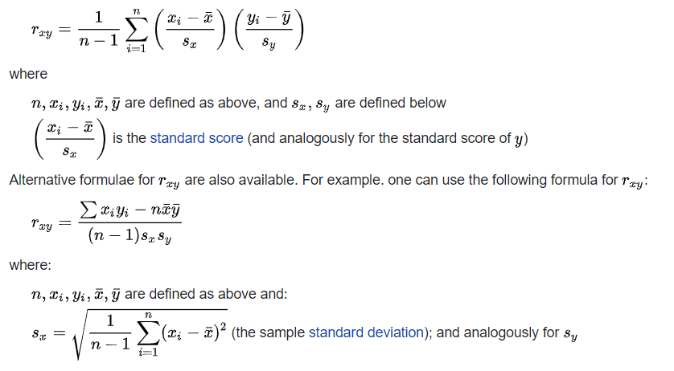
Formulation of r in terms of standard deviation (for sample)

Slide 13
Pearson Correlation r for population
See here:
https://www.statisticshowto.com/probability-and-statistics/correlation-coefficient-formula/

Slide 14
Interpretation of Correlation Coefficient, r
A correlation coefficient measures the extent to which two variables tend to change together. The coefficient describes both the strength and the direction of the relationship.
A range of values for r
r = 0 (no linear relationship)
1 > r > 0.5 (strong positive relationship)
0.5 > r > 0.1 (weak positive relationship)
0.1 > r > -0.1 (almost no relationship)
-1 < r <-0.5 (strong negative relationship)
-0.5 < r < -0.1 (weak negative relationship)
Source https://support.minitab.com/en-us/minitab-express/1/help-and-how-to/modeling-statistics/regression/supporting-topics/basics/a-comparison-of-the-pearson-and-spearman-correlation-methods/
https://www.mathsisfun.com/data/correlation.html

Slide 15
Correlation Hypotheses Testing Significance Testing for r value
Correlation Coefficient and Hypotheses Testing
The aim of the hypothesis testing is whether there is any linear relationship between two variables.
You will have to choose the confidence level (in this example, we shall choose confidence level as 95%, α = 0.05)
Assumptions – assumptions for a parametric test
Hypotheses
Null hypothesis H0: the two samples are independent (or correlation coefficient, r = 0)
Alternative hypothesis H1: there is a dependency between the samples (or correlation coefficient, r ≠ 0)
Find the r and p values
Alternative hypothesis, not equal => two-tailed test and therefore, confidence level, α, has to be halved.
Compare p value with α/2 = 0.025, and draw a conclusion (see Self Paced Tutorials) – see next slide
Sources
https://machinelearningmastery.com/statistical-hypothesis-tests-in-python-cheat-sheet/

Slide 16
Look at Example on Slide 10
The r coefficient value is 0.5298
We would like to test the significance of our r coefficient value
We will assume that our sample is drawn from a population with a zero correlation coefficient (i.e. no correlation)
Therefore we have two hypotheses:
Null hypothesis Ho: r = 0; (r is NOT Significantly Different From Zero; There is no Significant linear relationship between the two variables)
Alternative hypothesis Ha: r ≠ 0; (r IS Significantly different From Zero; There is Significant linear relationship between the two variables)
Methods
Method 1: Use r value and Table of critical values in Pearson r
Method 2: Use p-value

Slide 17
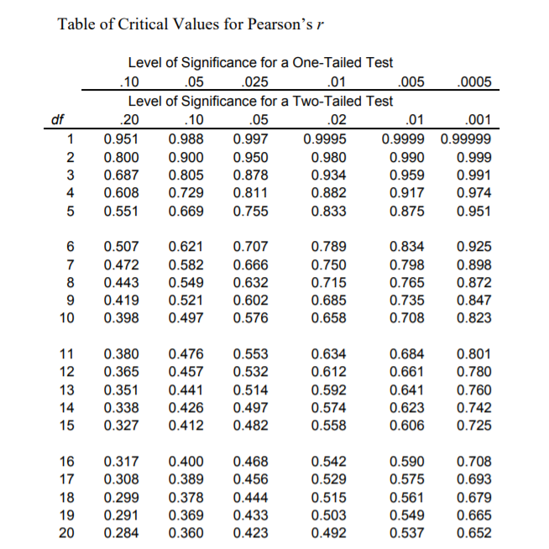
Method 1: Use Table of Critical Values for Pearson r
https://www.radford.edu/~jaspelme/statsbook/Chapter%20files/Table_of_Critical_Values_for_r.pdf
https://www.statology.org/pearson-correlation-critical-values-table/
https://onlinelibrary.wiley.com/doi/pdf/10.1002/9781118643624.app2
Example of Table of Critical Values for Pearson r

Slide 18
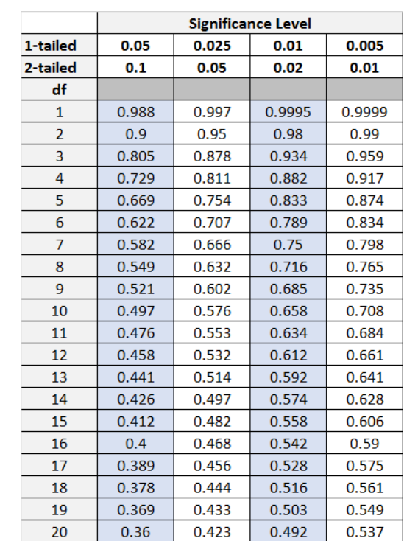
Known: calculated r = 0.5298; degree of freedom n-2 is 4; two tail test
Note this r critical table is for 1 and 2 tail tests.
Based on the table(look at the row for df = 4:
Confidence level (90%) (or α = 0.1), critical r value is 0.729; r < 0.729; accept null hypothesis (i.e. There is no Significant linear relationship between the two variables)
Confidence level (95%) (or α = 0.05), critical r value is 0.811
Confidence level (98%) (or α = 0.02), critical r value is 0.882
Confidence level (99%) (or α = 0.01), critical r value is 0.917

Slide 19
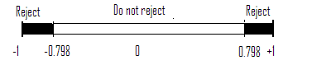
Method 1 Steps for Correlation Coefficient Hypothesis Test
If you can read a table — you can test for correlation coefficient.
Sample problem: test the significance of the correlation coefficient r = 0.565 using the critical values for the table. Test at α = 0.01 for a sample size of 9.
Step 1: Subtract two from the sample size to get df, degrees of freedom.9 – 2 = 7
Step 2: Look the values up in the Table. With df = 7 and α = 0.01, the table value is = 0.798
Step 3: Draw a graph, so you can more easily see the relationship.

Slide 20
Questions?

Slide 21

Method 2: Find p value
Step by step calculation:
Formula: Se_{r} – standard error; n is sample size; n-2 is degree of freedom; r is correlation coefficient (example in Slide 10, r = 0.5298)
Calculate the standard error (i.e. if Ho is true then we would expect r to be distributed about zero with a standard error of Se_{r}) (note: sample size n = 6); Use the formula Se_{r} = sqrt[(1 –r²)/(n-2)]
= sqrt[(1-0.5298²)/(6-2)] = 0.424061
The number of degree of freedom is: n-2 = 6-2 = 4
The test statistic, t = (r-0)/Se_{r} = 0.5298/0.424061 = 1.249348
From t statistic, obtain p value (see next slide).
Based on Ha, we will have two tail test

Slide 22
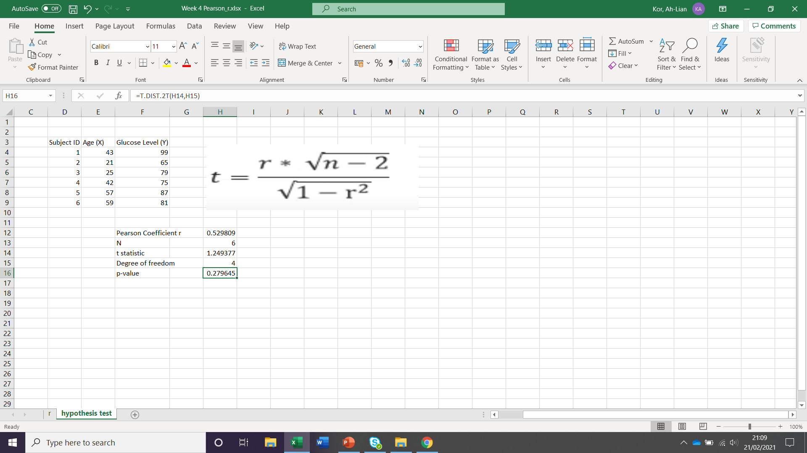
Find p-value if t-statistic is known

Slide 23
T. DIST. 2T function explained
T. DIST. 2T function is used to calculate the two-tailed Student's t-distribution, which is a continuous probability distribution that is commonly used in hypothese
The T.DIST.2T function in Excel has the following syntax:
=T.DIST.2T(x, degrees_freedom)
Where:
x is the numeric value at which you want to evaluate the t-distribution.
degrees_freedom is the number of degrees of freedom, which is typically equal to the sample size minus two (n-2).

Slide 24
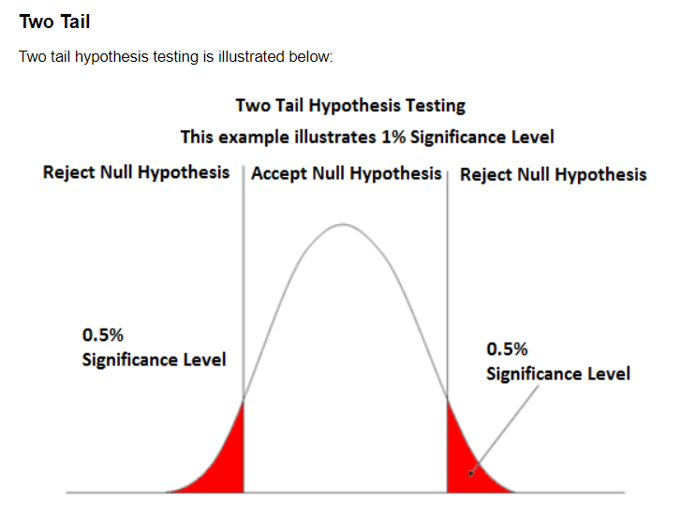
How to draw conclusion based on p-value?
p value is 0.279645
1% significance level or confidence level is 99%, α = 0.01
Two-tailed tests, α/2 = 0.005
P value, 0.279645 > 0.005, therefore accept null hypothesis (there is NO Significant linear relationship between the two variables)

Slide 25
Questions?

Slide 26
How to calculate p-value from Pearson r value
Watch this video https://www.youtube.com/watch?v=5-Hxm4o1HTA (Note: the p-value function is wrong – use =T.DIST.2T(tvalue, degree of freedom – see my excel file)
Calculator https://www.easycalculation.com/statistics/p-value-pearson-coefficient.php
Conclusion for tests https://courses.lumenlearning.com/introstats1/chapter/testing-the-significance-of-the-correlation-coefficient/

Slide 27
Chi Square (Why?)
Why talk about Chi Square:
1. The world is curious about the Chi-Square test's application in machine learning and how it makes a difference.
2. Feature selection is a critical topic in machine learning, as you will have multiple features in line and must choose the best ones to build the model.
3. By examining the relationship between the elements, the chi-square test aids in the solution of feature selection problems.

Slide 28
Chi Square (Why?)
Chi Square is a non-parametric test.
Two types of Chi Square Tests
Chi Square goodness of fit of observed and expected numeric variables
Chi Square of independence of two categorical variables
Sources
https://www.statisticssolutions.com/using-chi-square-statistic-in-research/

Slide 29
Chi-Square Goodness of Fit
Chi-square Goodness of Fit Test test is a non-parametric (distribution-free) method used to compare the observed and expected values from one categorical variable.

Slide 30
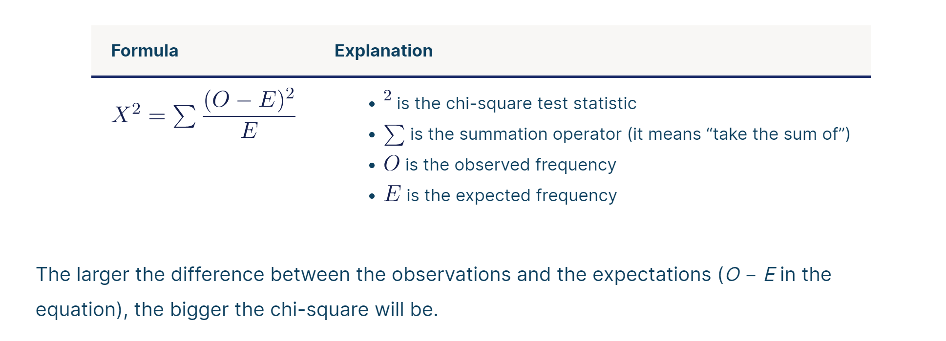
How to calculate Chi-Square (formula)

Slide 31
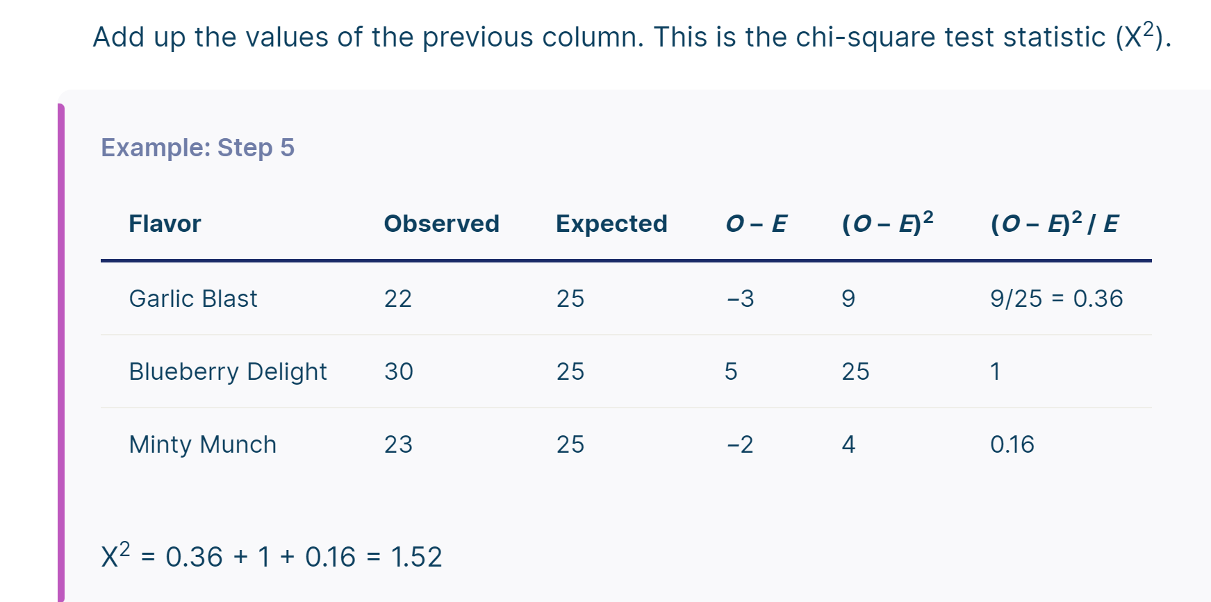

Slide 32
Further example could be found
Example (See Self Paced Tutorials): We assume to have two sets of data: (i) set of observed frequency for daily number of tourists that visit a museum in a week (f_obs); (ii) set of expected frequency for daily number of tourists that visit the museum in a week (f_exp).
The procedures for the Chi-Square Goodness of Fit Test are:
Choose a level of confidence. In this example, we shall choose 98%, a= 0.02
The hypotheses are as follows:
Null Hypothesis, Ho is there is no significant difference between the observed and expected values
Alternative Hypothesis, Ha is there is a significant difference between the observed and expected values
Interpret the results and draw a conclusion

Slide 33
Questions?

Slide 34
Example of Chi Square Goodness of Fit with Excel
Very good resource
https://www.youtube.com/watch?v=b3o_hjWKgQw
https://www.youtube.com/watch?v=mjCzU4WI2Gg

Slide 35
Chi-Square Test of Independence
It is a test of independence between two categorical variables
Interpretation of Chi Square Test of Independence
The Chi-square test of association evaluates relationships between categorical variables. Like any statistical hypothesis test, the Chi-square test has both a null hypothesis and an alternative hypothesis.
Null hypothesis: There are no relationships between the categorical variables. If you know the value of one variable, it does not help you predict the value of another variable.
Alternative hypothesis: There are relationships between the categorical variables. Knowing the value of one variable does help you predict the value of another variable.
Example – see Self Paced Tutorials
Sources
https://www.pythonfordatascience.org/chi-square-test-of-independence-python/

Slide 36
Questions?

Slide 37
Example of Chi Square Test of Independence
https://www.youtube.com/watch?v=VskmMgXmkMQ
https://www.youtube.com/watch?v=WXPBoFDqNVk

Slide 38
Summary
We talked about correlation and Chi square.
We discuss how to decide correlation or no correlation.
We also discuss how to use chi square for goodness of fit and test of independence.
We talked that we could use chi square for our feature selection in machine learning. But think about correlation, how is it useful for data analysis?

Slide 39
Why Correlation Analysis is Important
Reveal meaningful relationships between different metrics or groups of metrics.
Information about those connections can provide new insights and reveal interdependencies, even if the metrics come from different parts of the business.­­­­­­­
If there is a strong correlation between two variables :one of them is being observed acting in a particular way, then you can conclude that th­­­­­­­e other one is also being affected in a similar manner.
This helps to group related metrics together to reduce the need for individual processing of data.

Slide 40
The Benefits of Correlation Analysis
Reduce Time to Detection: In anomaly detection, working with a vast number of metrics and surfacing correlated anomalous metrics helps draw relationships that not only reduce time to detection (TTD) but also supports shortened time to remediation (TTR).
Reduce Alert Fatigue: important benefit of correlation analysis in anomaly detection is in reducing alert fatigue by filtering irrelevant anomalies (based on the correlation) and grouping correlated anomalies into a single alert.
Very annoyed: getting hundreds, even thousands of separate alerts from multiple systems, when many of them stem from the same
Reduce Costs: Correlation analysis helps significantly reduce the costs associated with the time spent investigating meaningless or duplicative alerts.

Slide 41
Thank you

